Slide 1
Twins MinneMUDAC
Dances with Data
Tony Pappas | Alex Bartholomew | Annie Zhao
Jack Callinan | Robert Mattson
Notes:
Alex
Hello, we are Dances with Data, and this is our presentation on how to increase game attendance here, at Target Field.

Slide 2
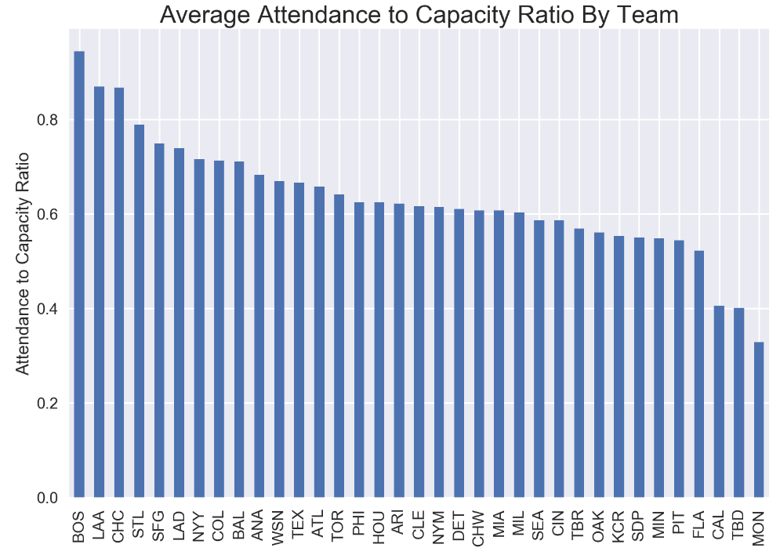
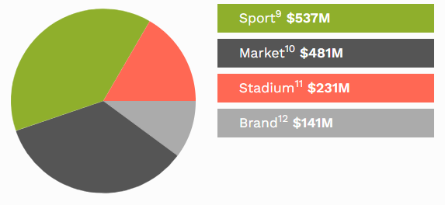
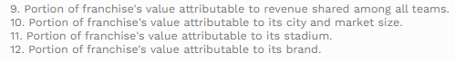
MLB Breakdown
Notes:
Alex
There are 162 games in the MLB seasons
Twins at .58
Around 81 of these are home games, provides chance to experiment and profit
16.6% stadium
Room for growth, twins have the capacity to handle it

Slide 3
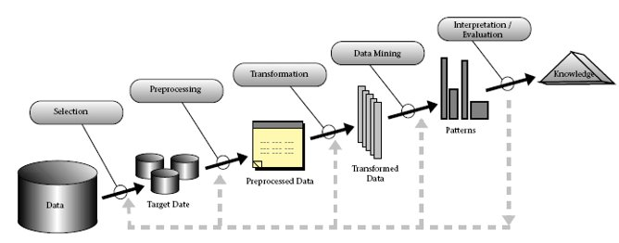
Methodology
Multiple Data Sources (Retrosheet, Baseball Reference, Forbes etc.)
Jupyter Notebook (Python Libraries)
Notes:
Alex

Slide 4
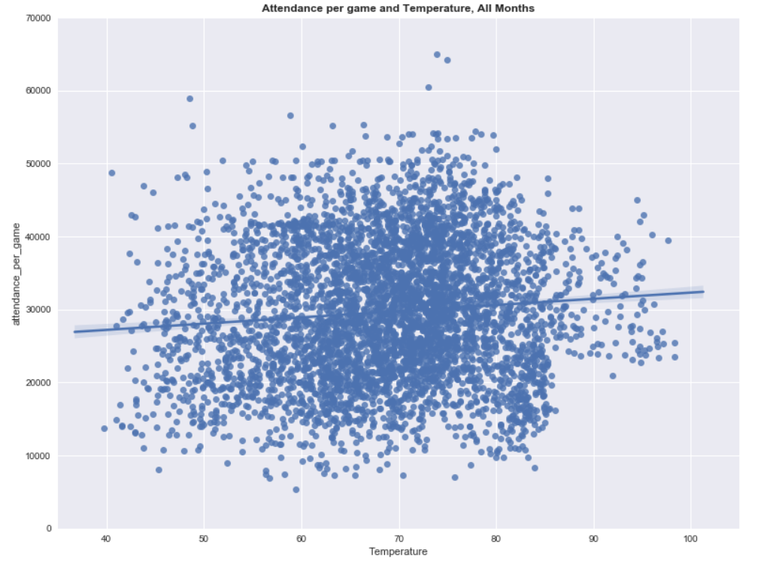
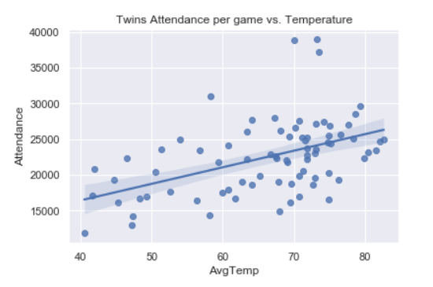
Temperature Analysis
MLB correlation coefficient: .09
Twins correlation coefficient: .48
Notes:
After comparing different whether data vs attendance, we concluded that factors like precipitation on game days does not have statistical significance, but an increase in average temperature does have an effect on increased attendance.
The MLB correlation coefficient: .09, Twins correlation coefficient: .48
This means that temperature does not have an effect on attendance for the league overall, but for the twins it is much more important because of large temperature variation.
Other weather data, precipitation not significant
.09 vs .48
Not league, yes twins

Slide 5
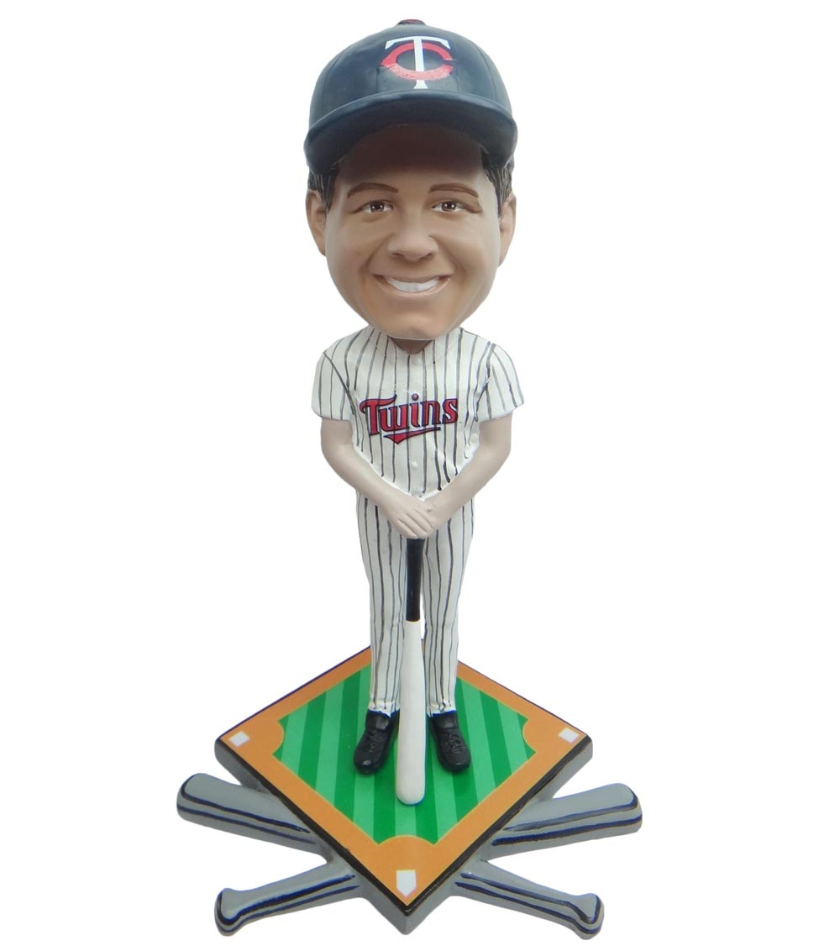
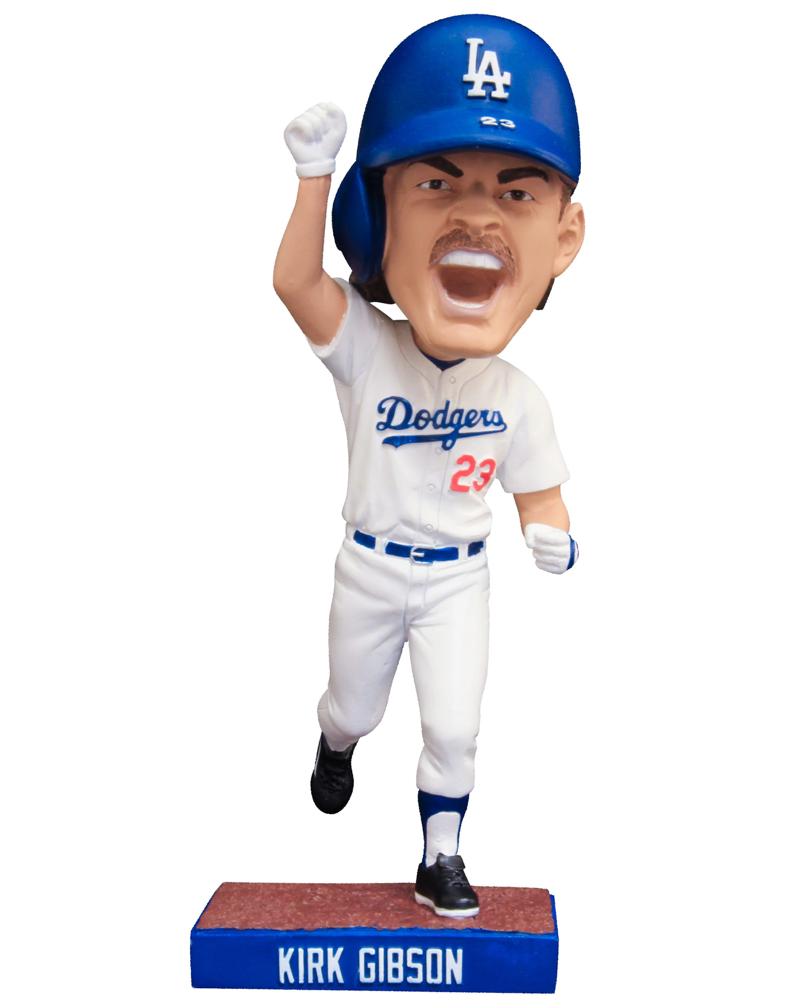
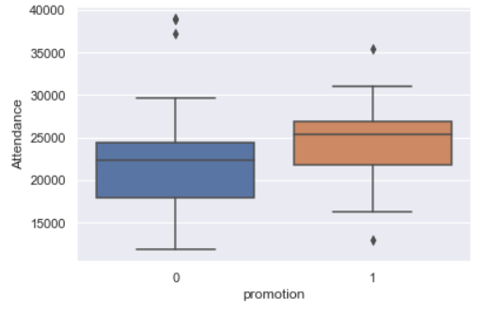
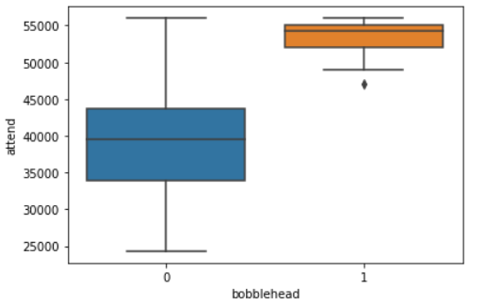
Battle of the Bobbleheads
Attendance increase: 3113
Revenue increase pg: $121,220
Revenue increase ps: ≈ $10 million
Attendance increase: 5500
Revenue increase pg:$276,000
Revenue increase pg:≈ $22 million
Notes:
Here we looked into the effect of promotions for twins attendance using an ordinary least square’s regression that Holds all other variabls constant for coeffictient.
We then compared that to the effect of bobble head promotions for the dodgers.
The twins had 23 total 2022 season promos Twins which increased attendance by around 3000 people per game. The dodgers had 16 bobblehead specific promos during the same season which resulted in a 5,500 increase in attendance per game.
Therefore, we concluded that by making more bobblehead promotions the twins could increase revenue by as much as 10 million.

Slide 6
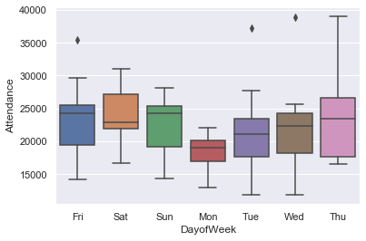
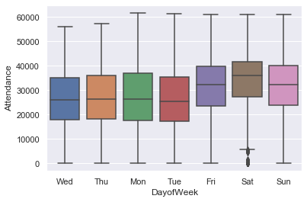
Battle of the Bobbleheads
Twins Attendance by Week
MLB Attendance by Week
Promotions Improve Monday Attendance by ≈ 1,000
Notes:
Next we used an ordinary least squares regression to compare the effect of day of the week on attendance.
We found that Monday was the worst performer on attendance and because of that we recommend increasing promotions on Monday.
This will increase the attendance by approximately 1000 people per week.
Ordinary Least Squares regression (OLS) is a common technique for estimating coefficients of linear regression equations which describe the relationship between one or more independent quantitative variables and a dependent variable

Slide 7
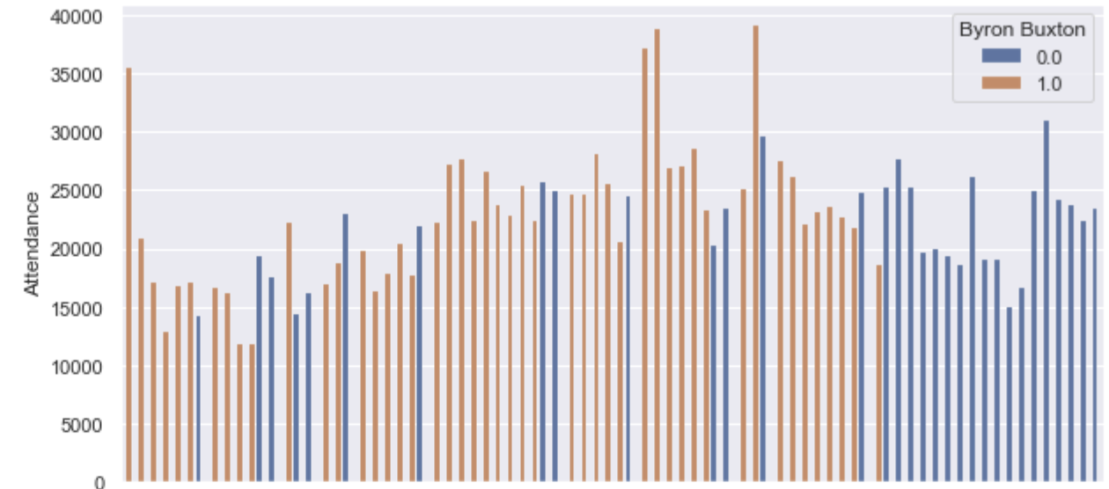
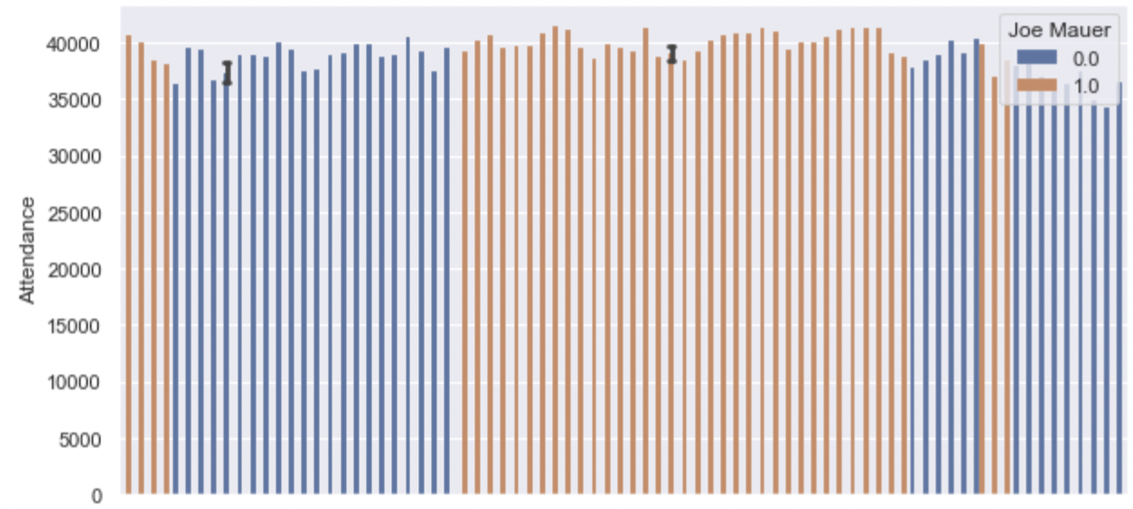
Players
Byron Buxton 2022 Season
Injury Prone
Increase attendance ~1k
Joe Mauer 2011
While playing vs not
Increase attendance
Home grown player
~2k
Notes:
RJ
Another aspect of attendance we wanted to take a look at was twins star players. We specifically look at Byron buxton’s 2022

Slide 8
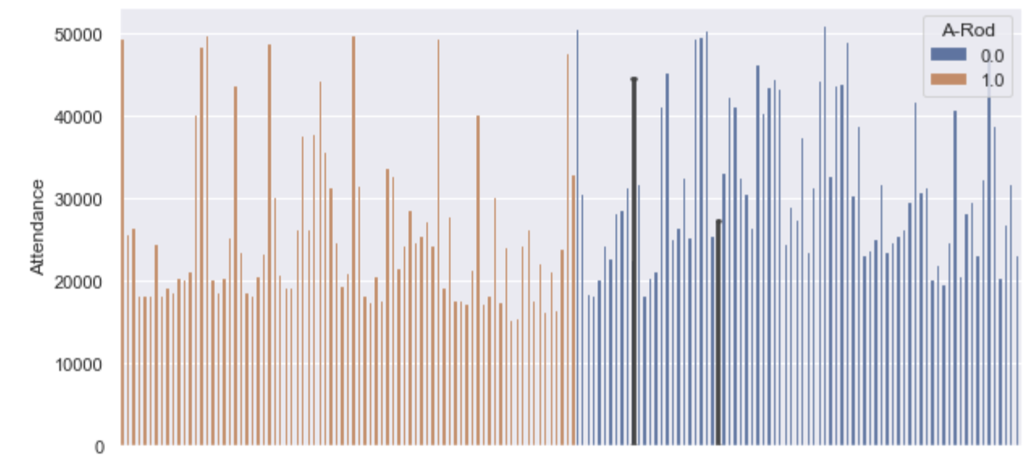
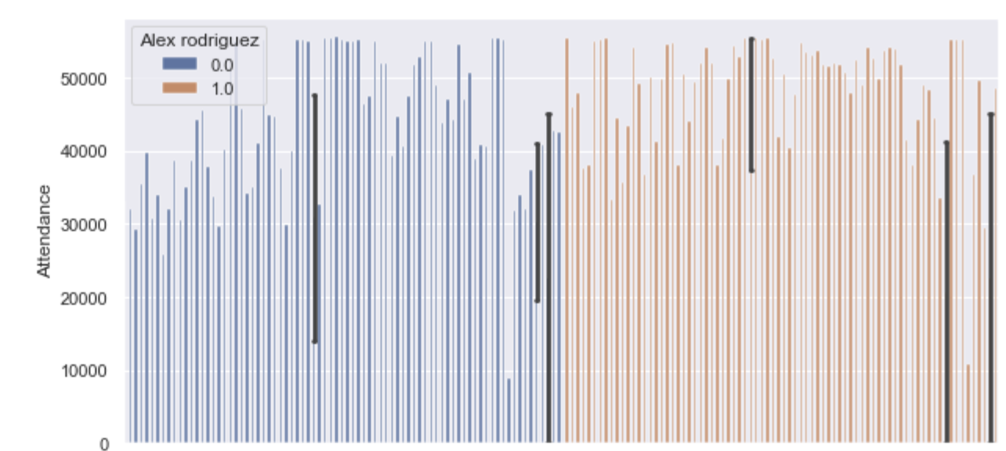
Players
Alex Rodriguez 2003 Trade
Rays
With ~25k
Without ~31k
New York Yankees
Without ~42k
With ~47k
Notes:
RJ

Slide 9
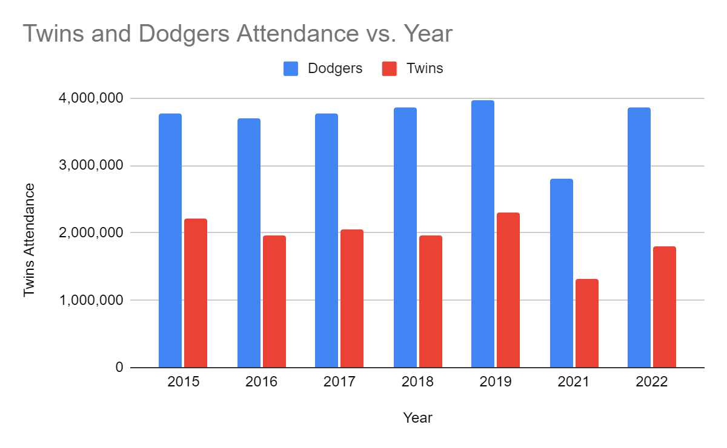
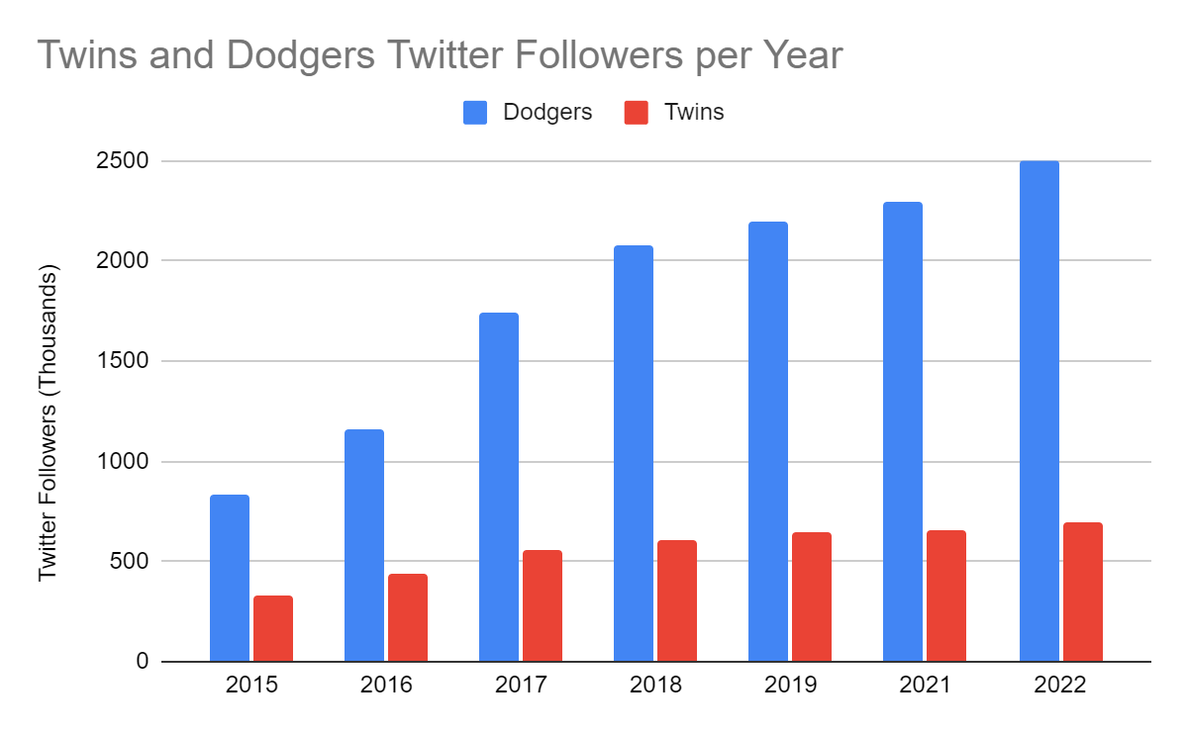
Social Media Analysis

Slide 10
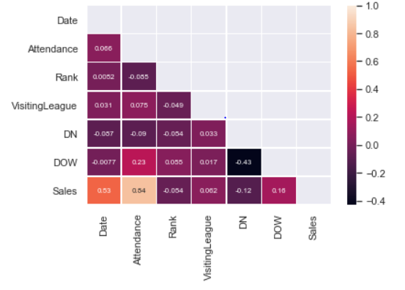
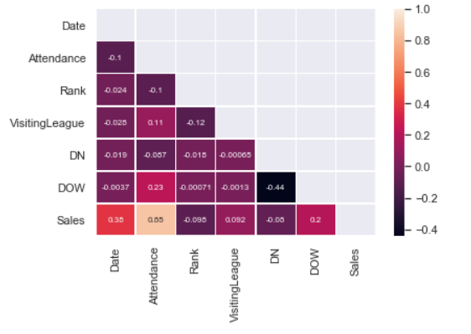
Predictive Modeling: Features
Twins 2022 Season
MLB 2020-2022 Season

Slide 11
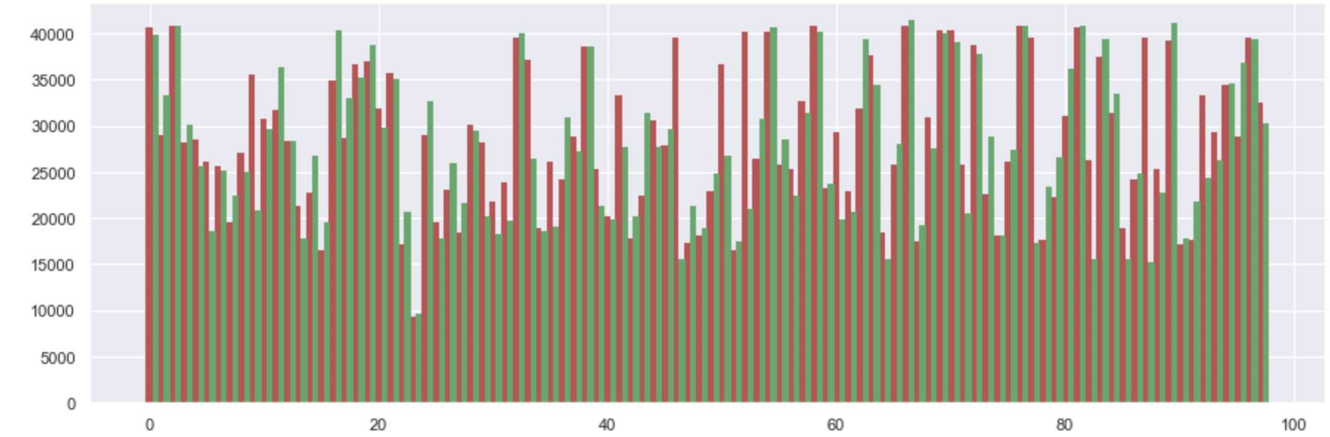
Predictive Modeling: Random Forest Regression
Mean Error: 3,450
Notes:
ALex

Slide 12
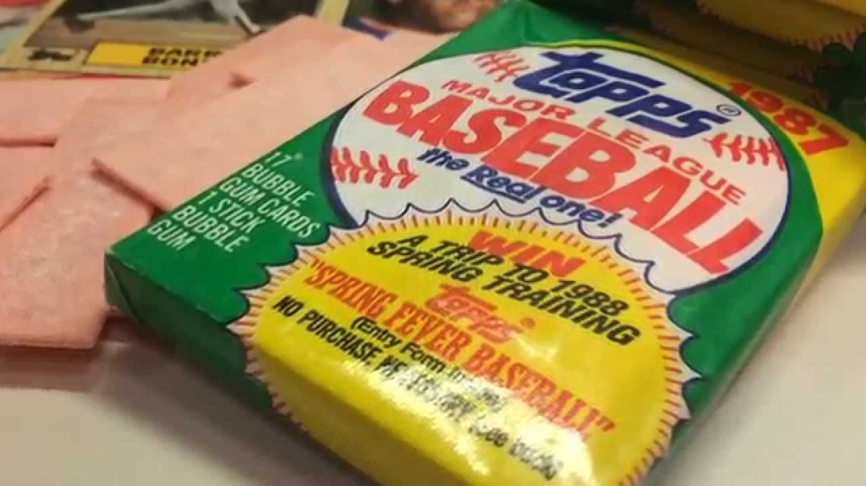
Solutions
Augment Promotions
Fanalytics
Customer Segmentations
Fan Score
IoT Stadium (Advertising, Concessions etc.)
Promote Home Grown Players
Gamification Framework
Variable Ticket Pricing
Wait for Global Warming!
Notes:
More Promos more attendance companies want to give free promos at twins or pay to give promos at twins games for more exposure. Does wonders for our attendance, imagine what it will do for your product sales
Players that are home grown gain a lot of popularity among fans. People are more willing to go see a home grown player they have a connection with play than an outside player. Marketing around certain players is incredibly important.
Gamification examples free games free beer get them back to the stadium, social media network addiction

Slide 13
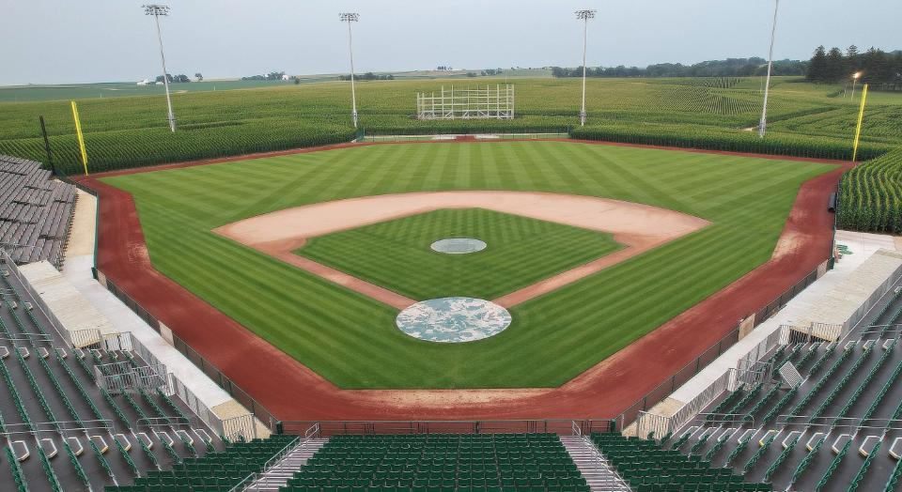
"People will come" - Terence Mann
Notes:
There is a potential for an entirely different experience this year and the twins should be at the forefront of it.

Slide 14
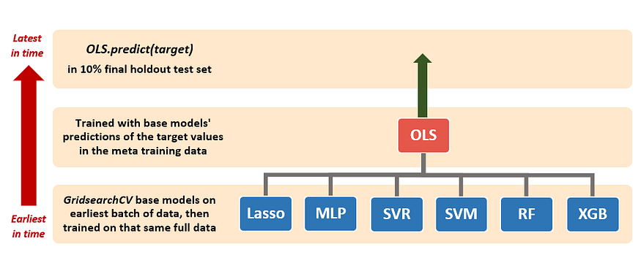
Predictive Modeling: Stacking

Slide 15
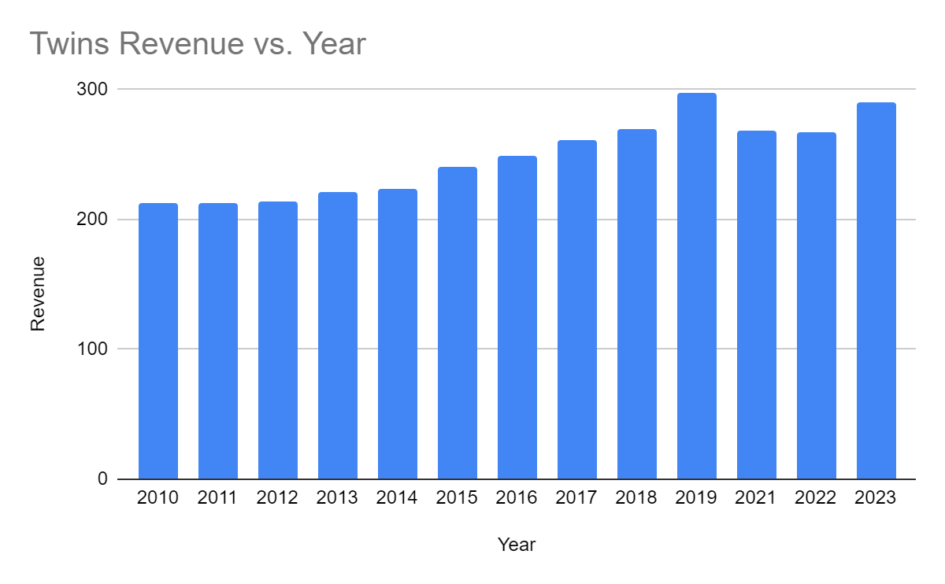
Financial Analysis: Revenue
2023 Season Revenue Forecast: $290 million
9% increase over 2022 Season

Slide 16
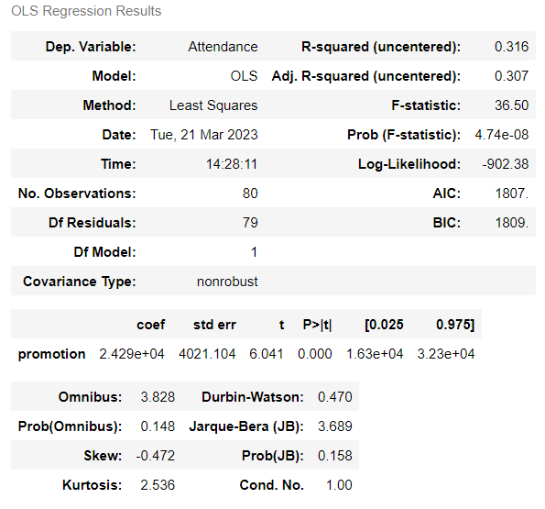
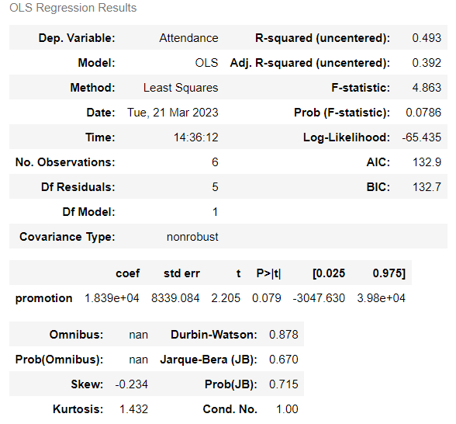
Financial Analysis: Promotions
Full Season
All Mondays

Slide 17
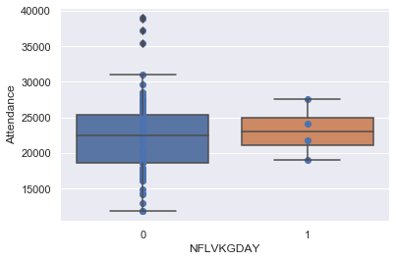
NFL
Full Season
All Mondays

